Slide 1

Introduction for CH-420

Slide 2
Course
Organization: lectures + exercises
Course outline (Details on Moodle)
Block 0: Introduction + Computational carpentry
Block 1: Statistical theromodynamics
Block 2: MC & MD
Block 3: Ensembles
Gradings
Proof of work
2 reports: one chosen by themselves, one assigned by us
It is advised that you choose a block by mid-semester, so that you can already start working on the report.
The other block will be assigned by the end of Block 2.
You can (and should!) discuss in groups, but the reports should be individual (therefore different from each other)
Please upload the report as pdf separately, like block1_$name.pdf,block2_$name.pdf
Oral presentation with slides on two blocks (proposed date 27/05)
Prepare slides based on both of your reports and your understanding of the exercises.
On site in principle. Ask Prof. for special cases.
We encourage you to be active on the “Questions?” forum (on moodle) and help each other there. If all questions and insights are shared, then everyone benefits from it.

Slide 3
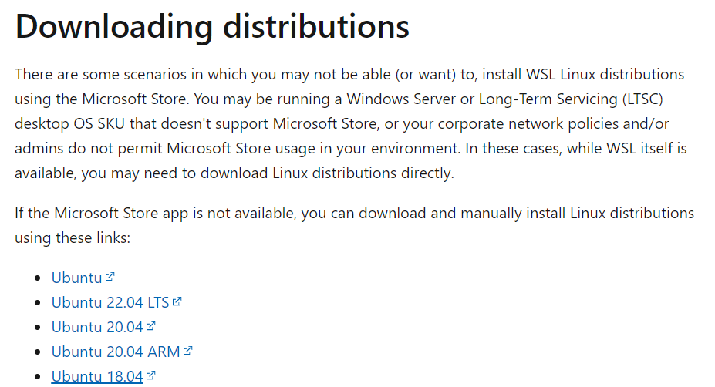
Environment setup
Follow “Setup your computational enviroment” Part.
For environment setup for window, if Ubuntu installation is not successful in Microsoft store, you need to do one more step.
Download Ubuntu18.04 (apx format) from https://learn.microsoft.com/en-us/windows/wsl/install-manual

Slide 4
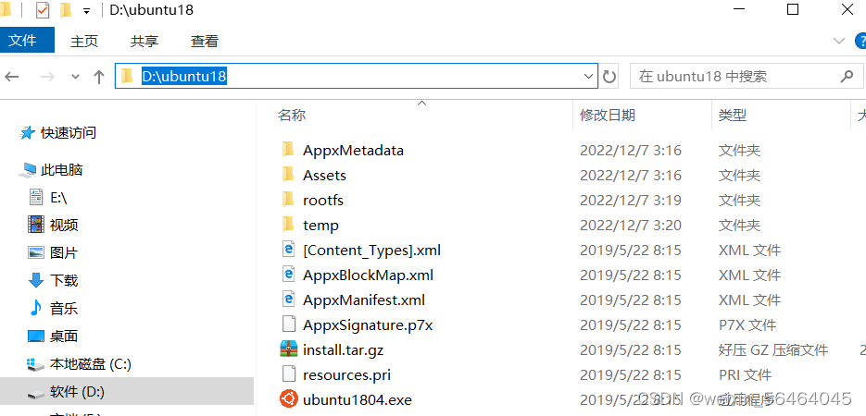
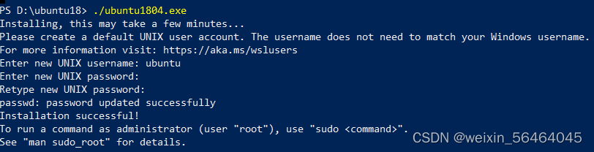
Ubuntu install in window:
Rename the file from .apx to .zip and unzip the file
Open the powershell with administrator rights and execute the ubuntu18.exe file
Type the account name and password for your linux system

Slide 5
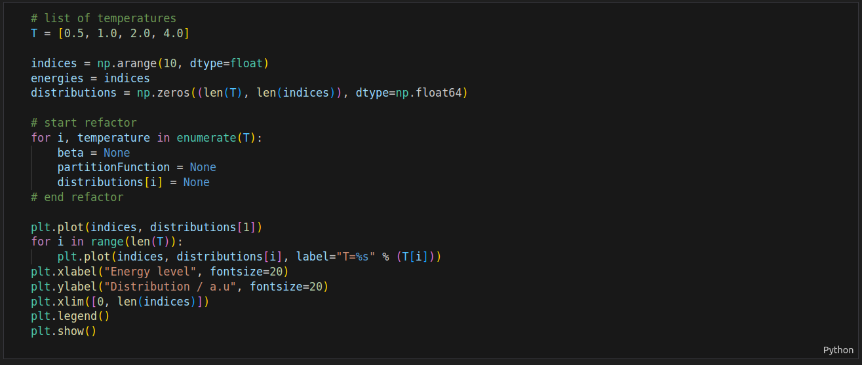
Example of jupyternotebook:
Go with # and you will see the code you need to modified

Slide 6
Thank you for your attention!
Contact: yutao.li@epfl.ch or xin.jin@epfl.ch

